Slide 1

CS-GY 6083 Principles of Database Systems Pokemon Master
Ryan Cheng(kc4532)
Wei-Neng Hsu(wnh215)

Slide 2
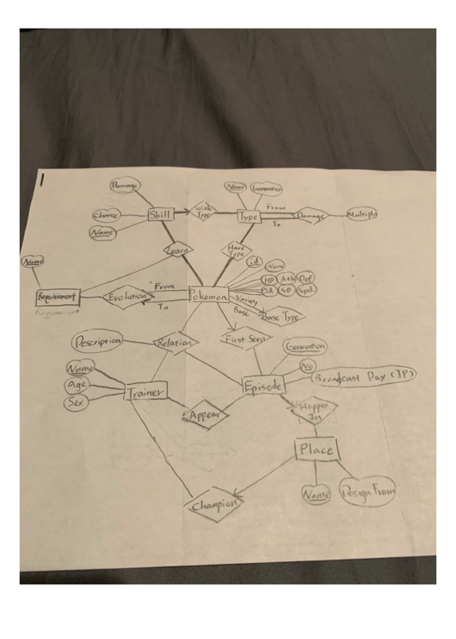

Slide 3
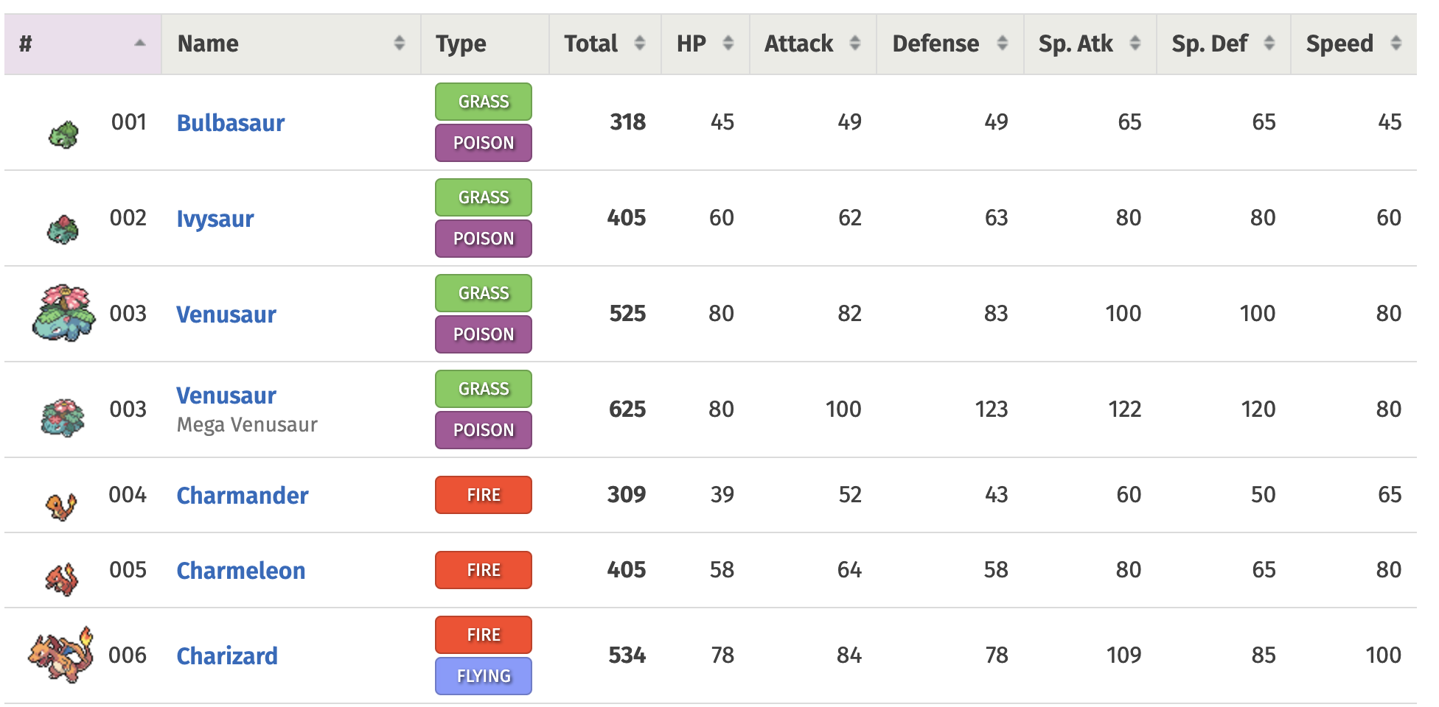
Data
Pokémon fandom
Pokémondb.net
Pokémon wiki

Slide 4

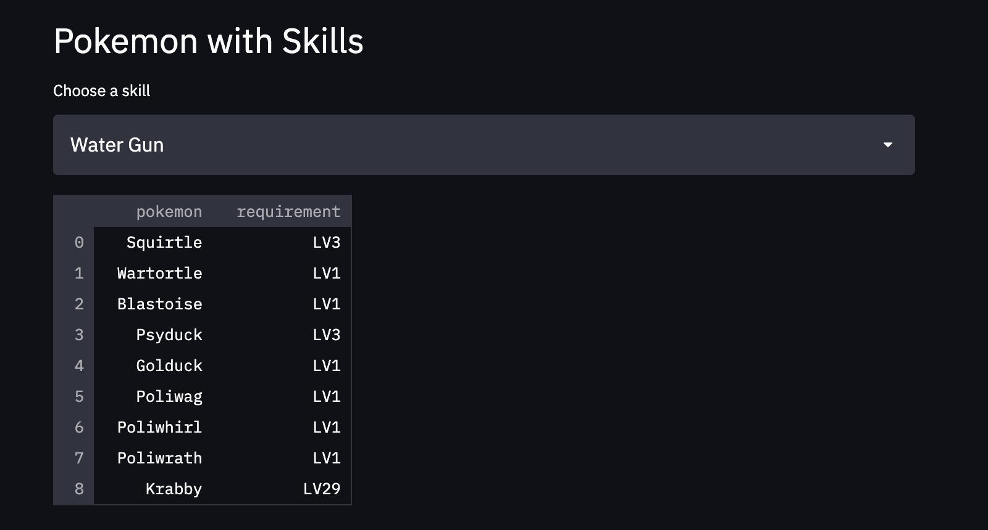
Query
Check out who could learn the desired skill
Comparing the learning requirement for the chosen pokemons

Slide 5

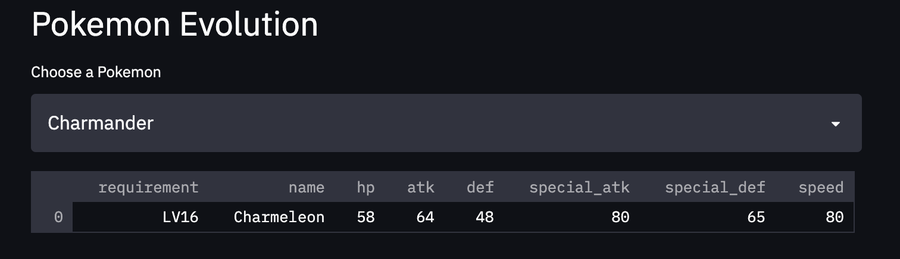
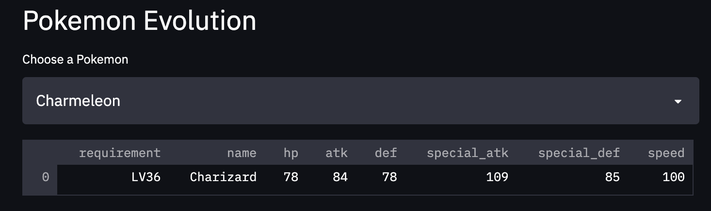
Query
Check out the evolution of a selected Pokémon

Slide 6
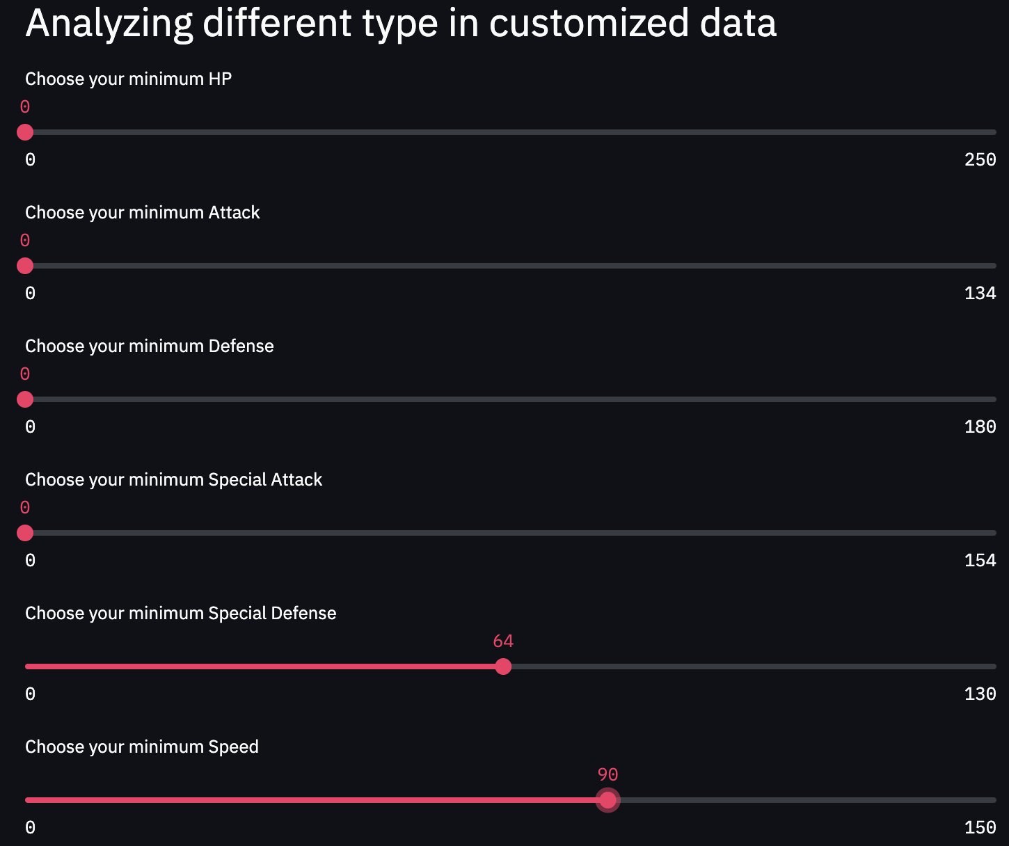
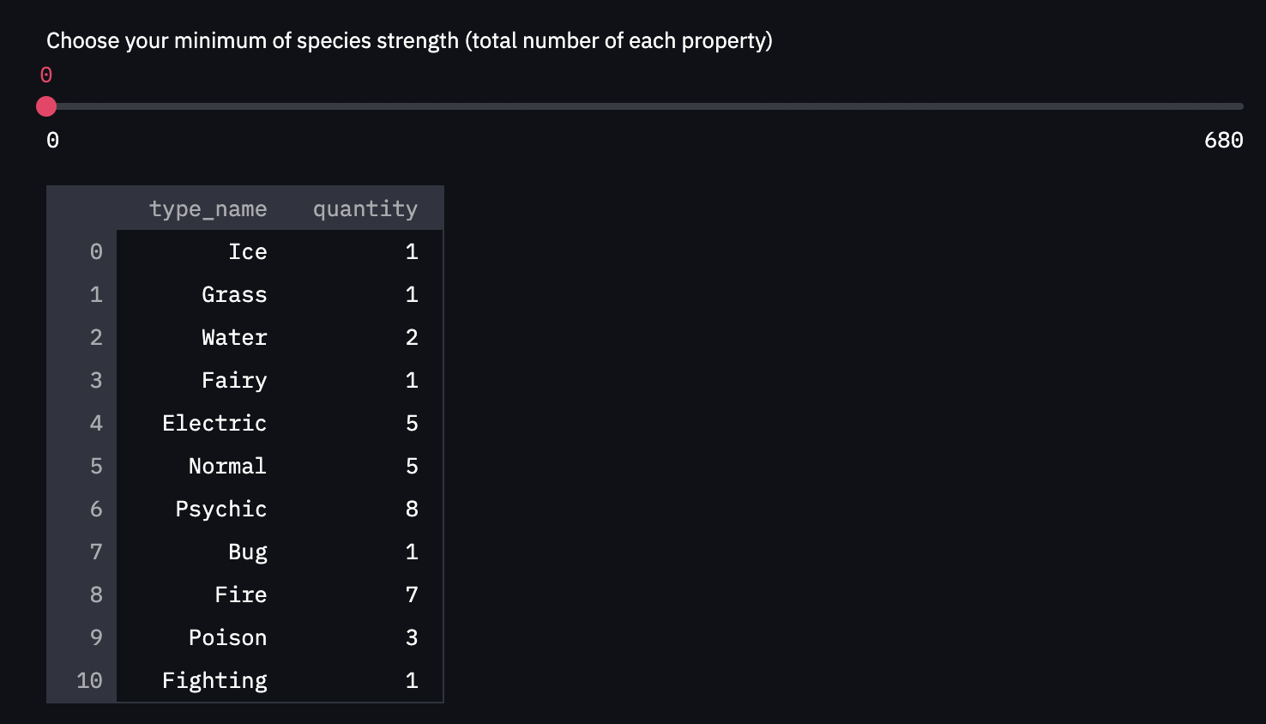
Query
Input the desired characters of Pokémons’ by sliding the bars
Showing the matching numbers of Pokémon by types

Slide 7

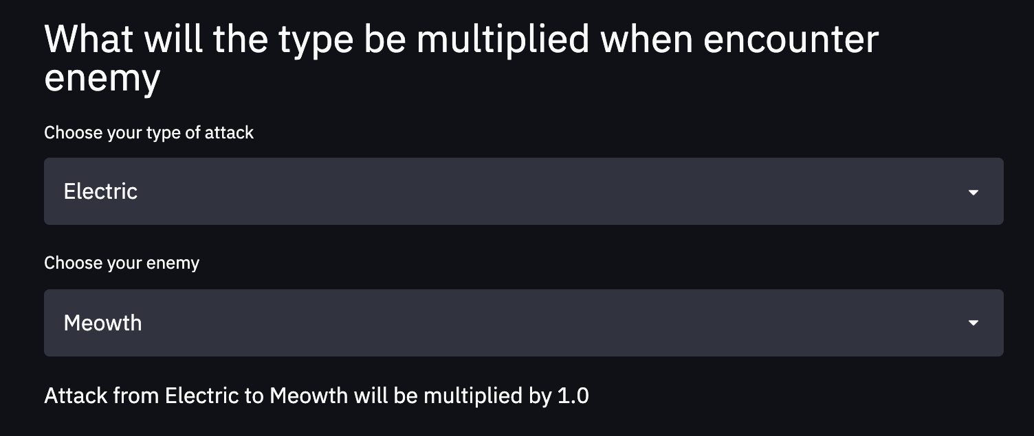
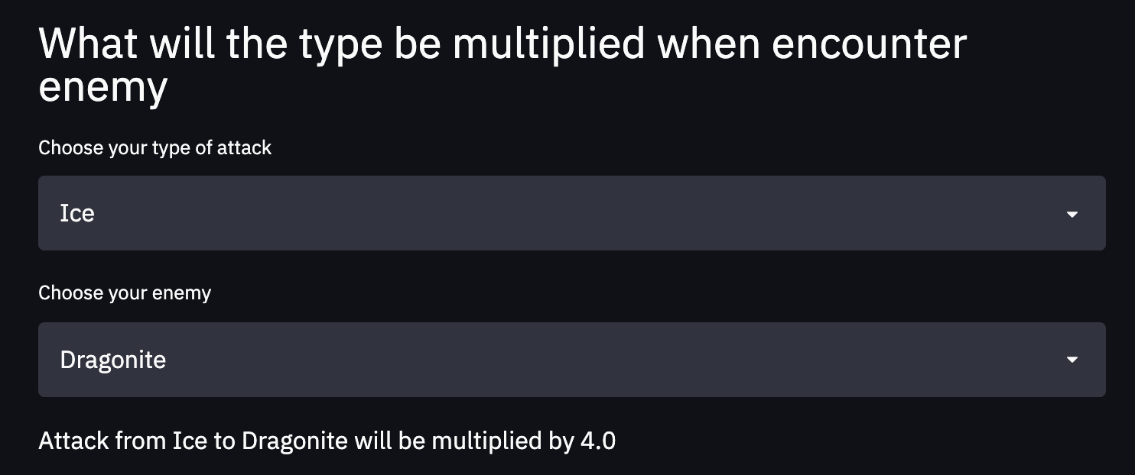
Query
Type matters
How to beat dragonite?

Slide 8

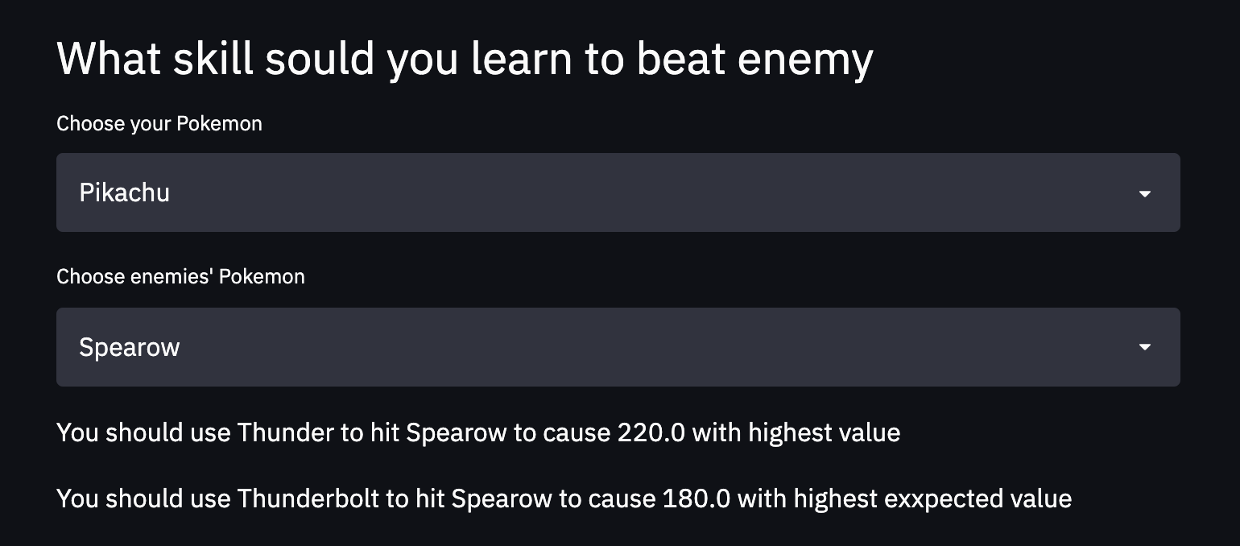
Query
Learn which skill?
Use which skill?

Slide 9
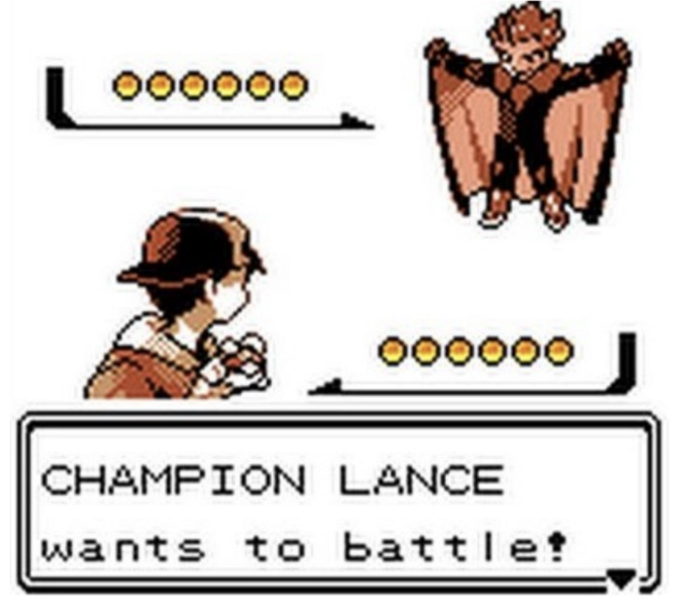

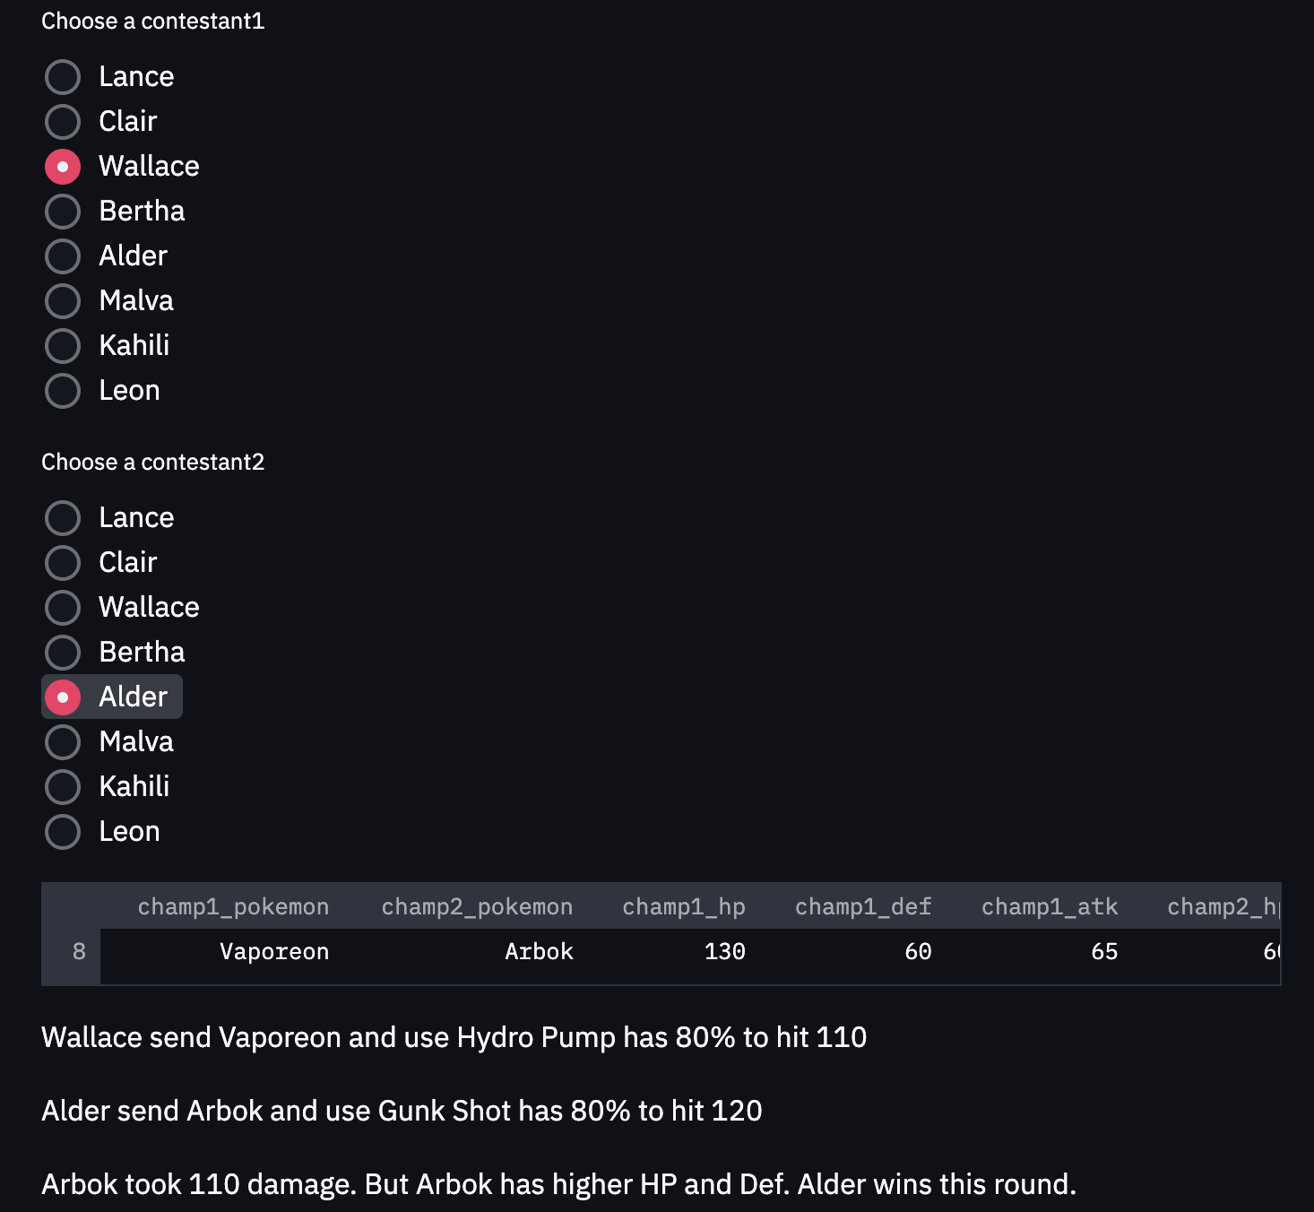
Query
Battel rocks
Champion vs Champion

Slide 10

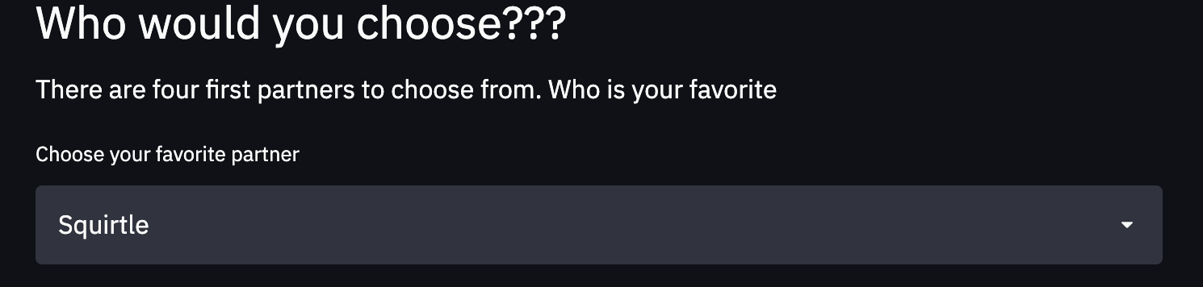
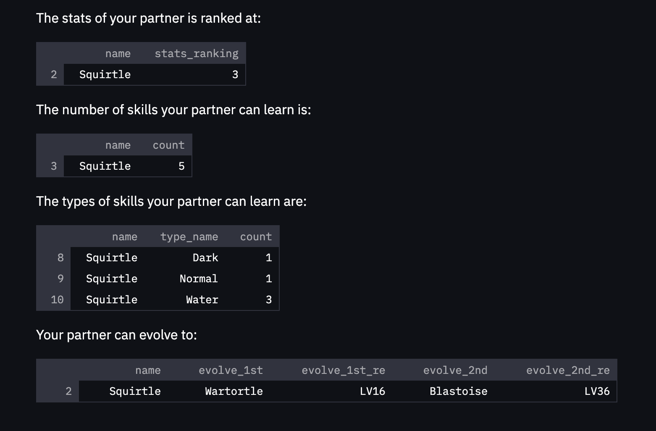
Query
4 starter Pokémon
Stats compare
Skill compare
Evolution compare

